Slide 1
Eco-trace: your carbon footprint story
TEAM:
Chaitanya reddy
P. Sharanya
B. Advaitha Lahari

Slide 2
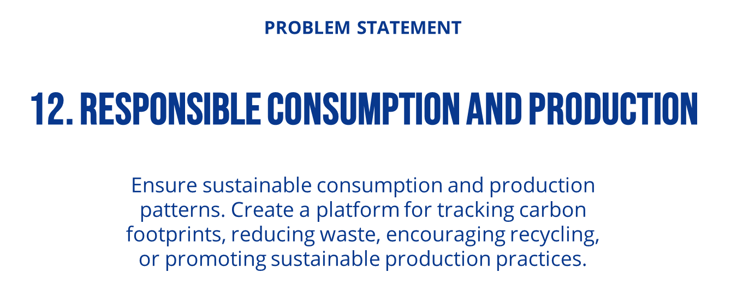

Slide 3

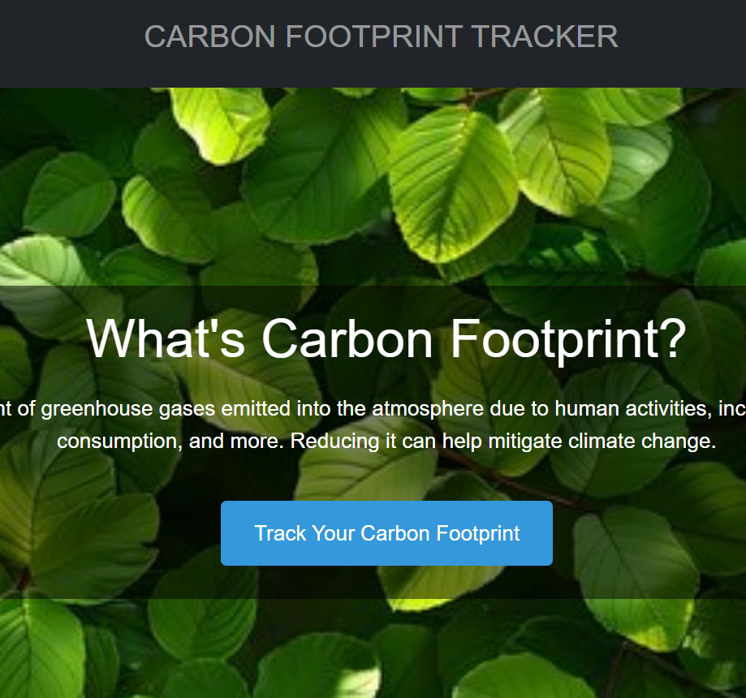
Solution - Eco Trace Website
Eco Trace is a platform designed to help individuals and businesses track their carbon footprints, reduce waste, encourage recycling, and adopt sustainable production practices.

Slide 4
01
Design overview
The flow of the website

Slide 5
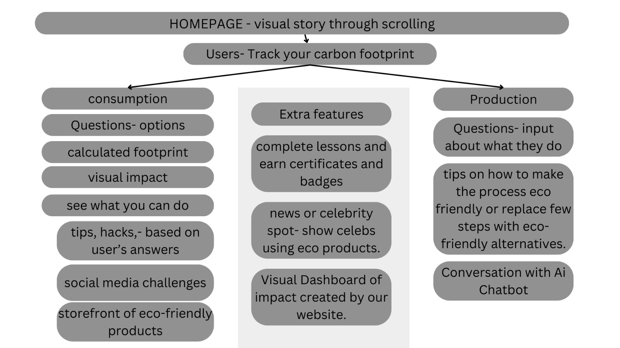

Slide 6
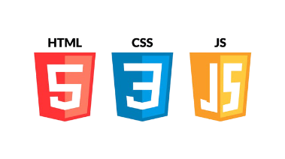

Tech stack used:
Frontend:
React.js: Used for building the user interface with interactive components.
HTML/CSS: For structure and styling.
Javascript: used to enhance the user interface and create an interactive experience for the end-users.
Deployment:
Netlify: For hosting the frontend.

Slide 7
02
Design process
Process of building this website

Slide 8
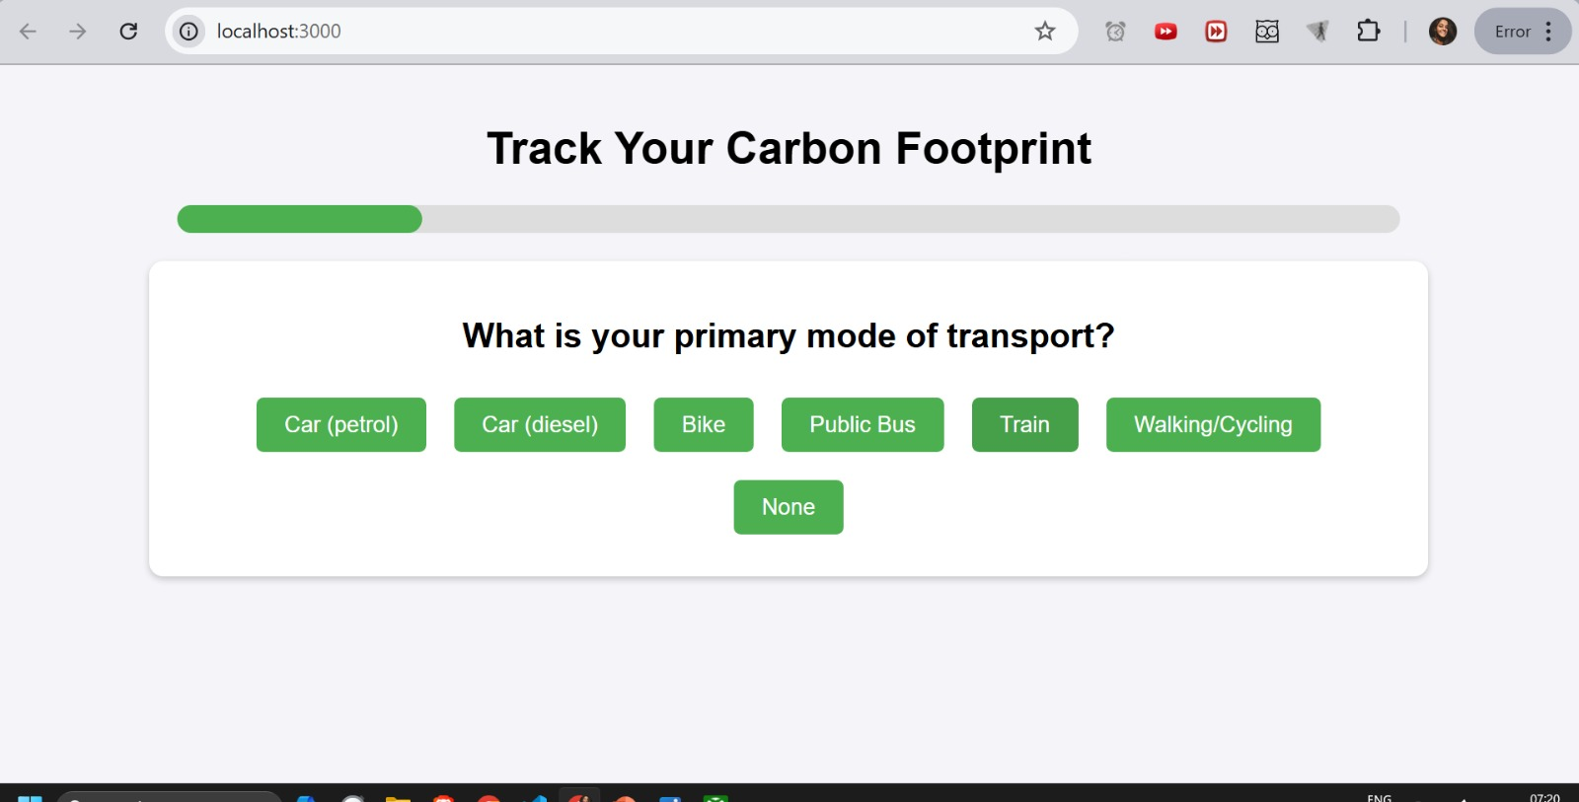
Web demo
Lets take a look at the interactive web demo!

Slide 9
THANKS!
Please keep this slide for attribution

